Slide 1

Drugs effectiveness for certain conditions
Authors: Robert-Alexandru Delicostea & Andreea-Diana Ciocaianu

Slide 2
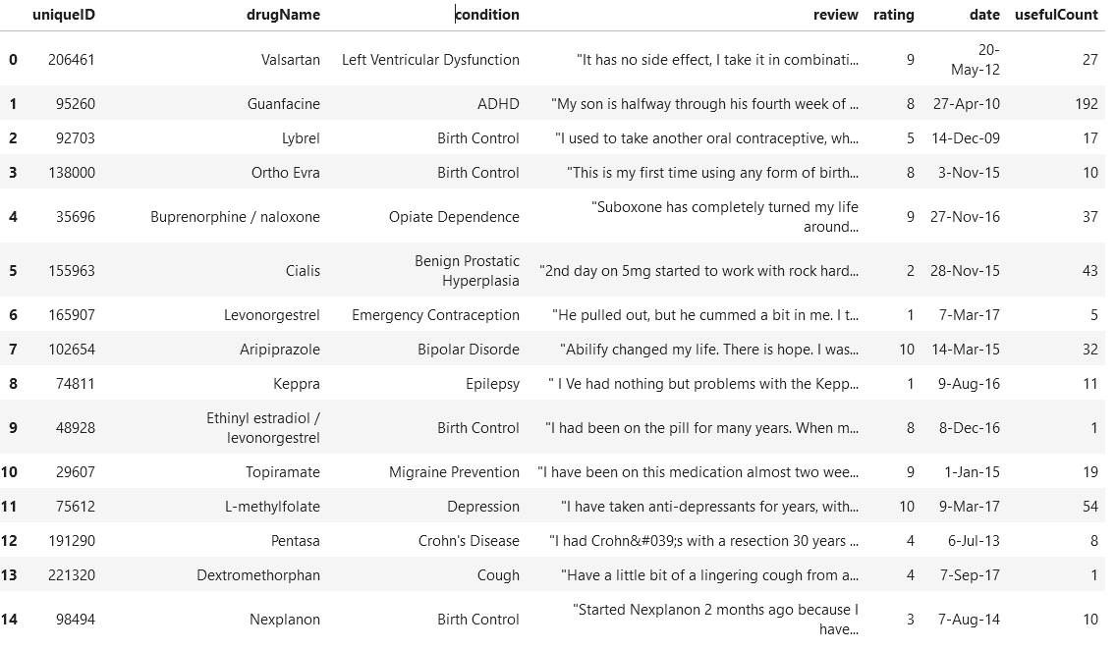
-The dataset – UCI ML Drug Reviews
Reviews on different kinds of drugs with the condition they were meant to treat rated based on a 10-star system according to the overall patient satisfaction

Slide 3
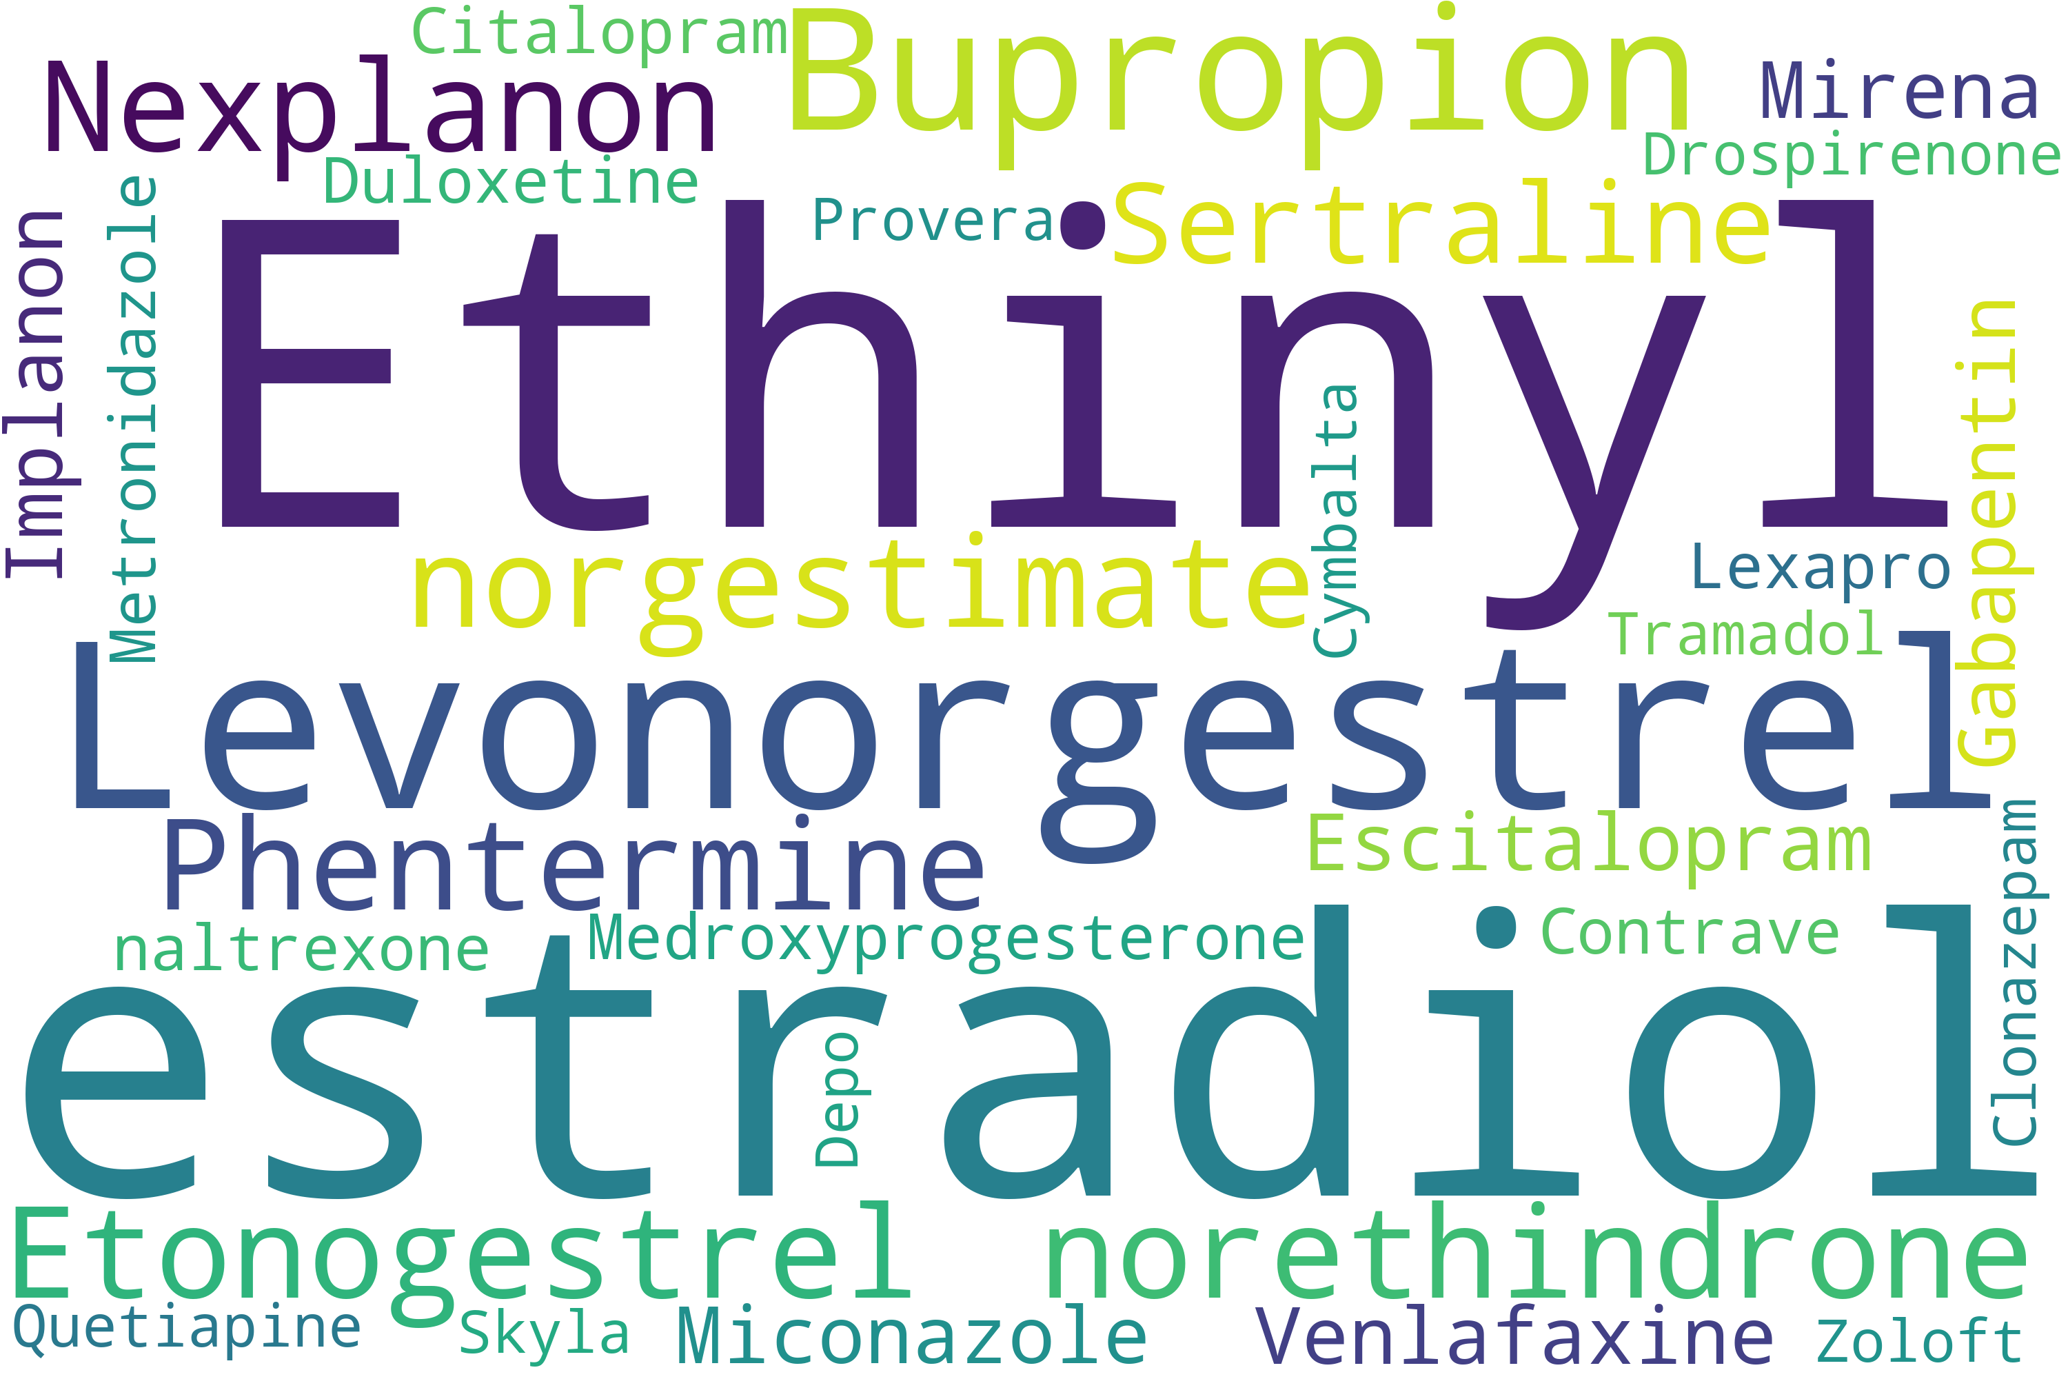
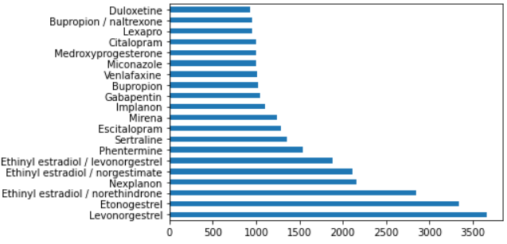
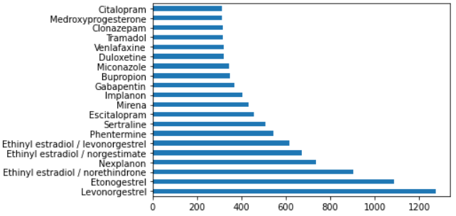
Top 20 drugs
Train dataset
Test dataset

Slide 4
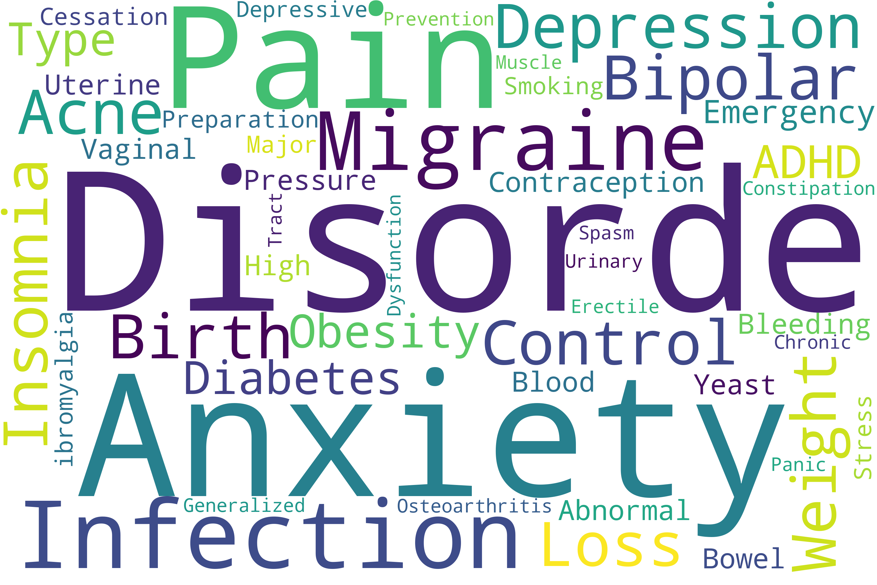
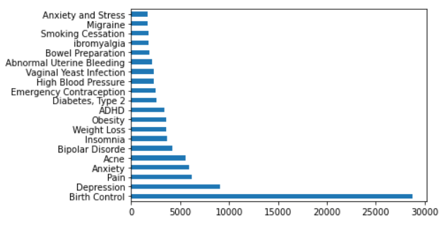
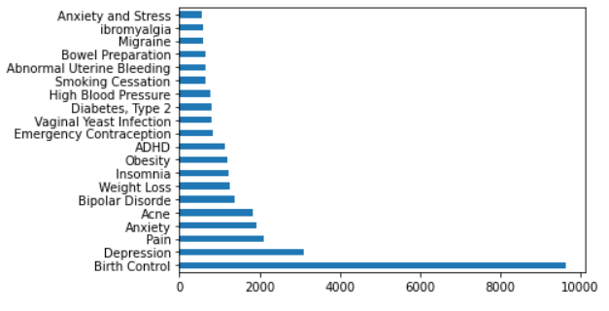
Top 20 conditions
Train dataset
Test dataset

Slide 5
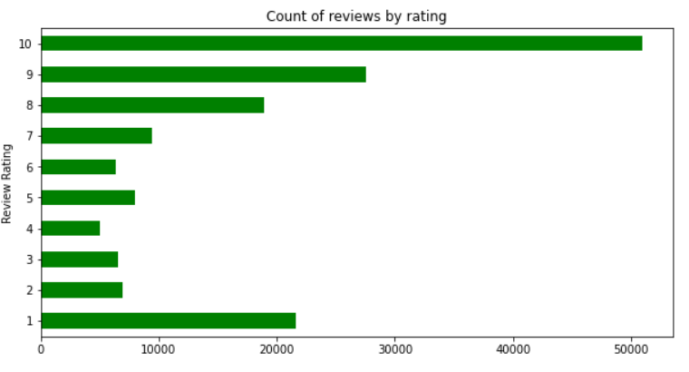
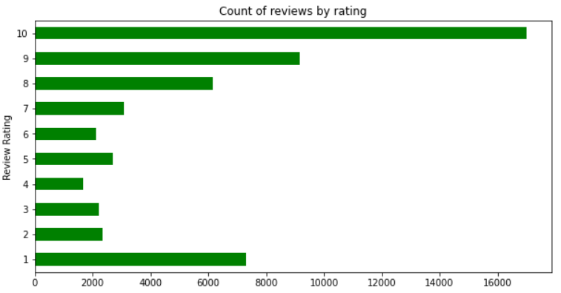
Review distribution based on rating
Train dataset
Test dataset

Slide 6
Using the dataset – Part 1
Step 1: creating an improved rating using the existent rating column and the usefulCount
Step 2: compute a sentiment for each review using either the review or the improved rating
Step 2 – option A – using the improved rating, assign a sentiment(negative/neutral/positive) for each review
Step 2 – option B – using the review and specific sentiment analysis models, compute a sentiment(positive/negative) for each review
Pre-processed Review Data
Vectorizer/ Tokenizer
Classification Model/ Neural Network
Binary/Ternary Sentiment

Slide 7
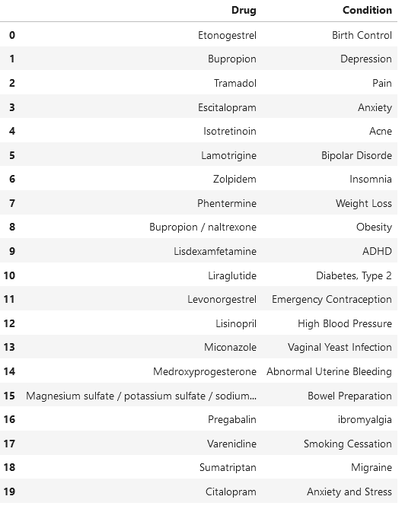
Using the dataset – Part 2
Step 3: create a score-based relation between a drug and a condition
Step 4: use the output from each step to get the overall effectiveness of a drug

Slide 8

Thank you for your attention

